Slide 1


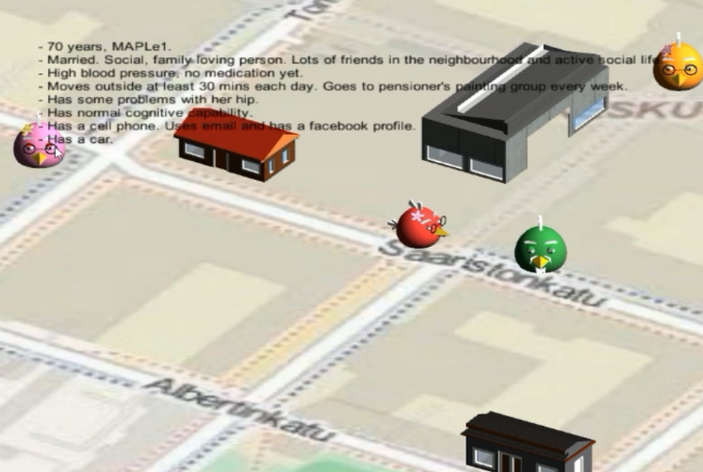
BlindBirds: Tele-presence based Mentor-Apprentice Learning Environment for Visually Impaired Persons
Babar Chaudary
University of Oulu, Finland.

Slide 2
TEAM INTRODUCTION
# | Name | Email | Role | Task
1 | Babar Chaudary | Babar.chaudary@oulu.fi | Supervisor | --
2 | Aryan Firouzian | Aryan.Firouzian@oulu.fi | Supervisor | --
3 | Rajeeka Ponrasa | rajeeka1@gmail.com | Project manager & Graphic Designer | Avatar Design
4 | Keino Eliud | elkeino@gmail.com | End user testing | Voice & Haptics
5 | Supasonk Kotanut | supasonk@gmail.com | Programmer | Help Subsystem
6 | Sorrawit Chancherngkit | Sorrawit.c@ku.th | Programmer | Help Subsystem
7 | Shawnh Siung | Shawnhsiung07@gmail.com | Programmer | HMD Support
8 | Corentin Vitour | corentin.vitour@gmail.com | Programmer | HMD Support
9 | Pierre Laize | pierrelaize50@gmail.com | Programmer | HMD Support
10 | Diogo Barros | finkry@gmail.com | Graphic Designer | Avatar Design

Slide 3
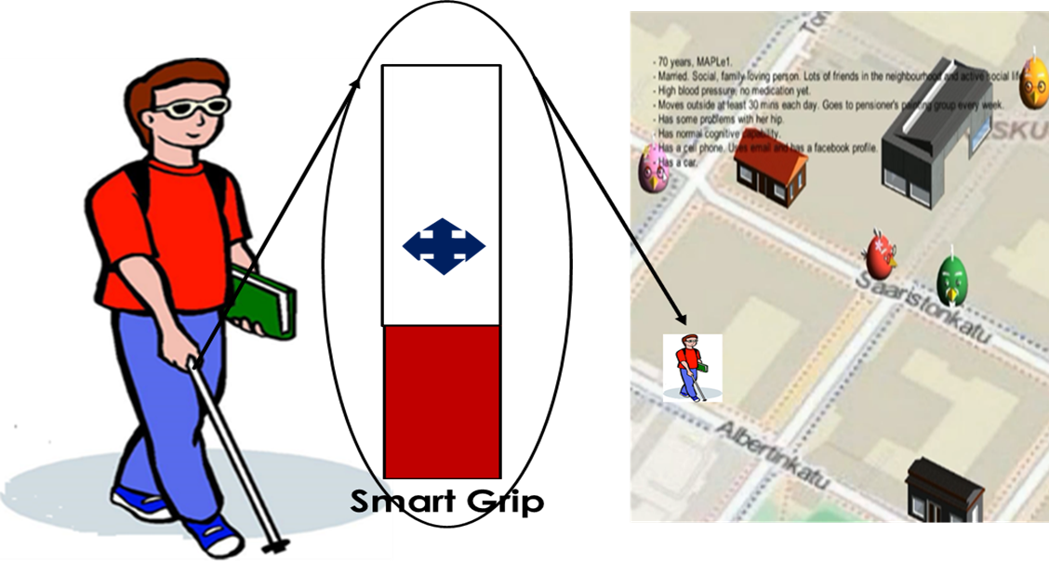

GAME IDEA
The idea behind BlindBirds is to develop it as a Tele-presence based Mentor-Apprentice Learning Environment.

Slide 4
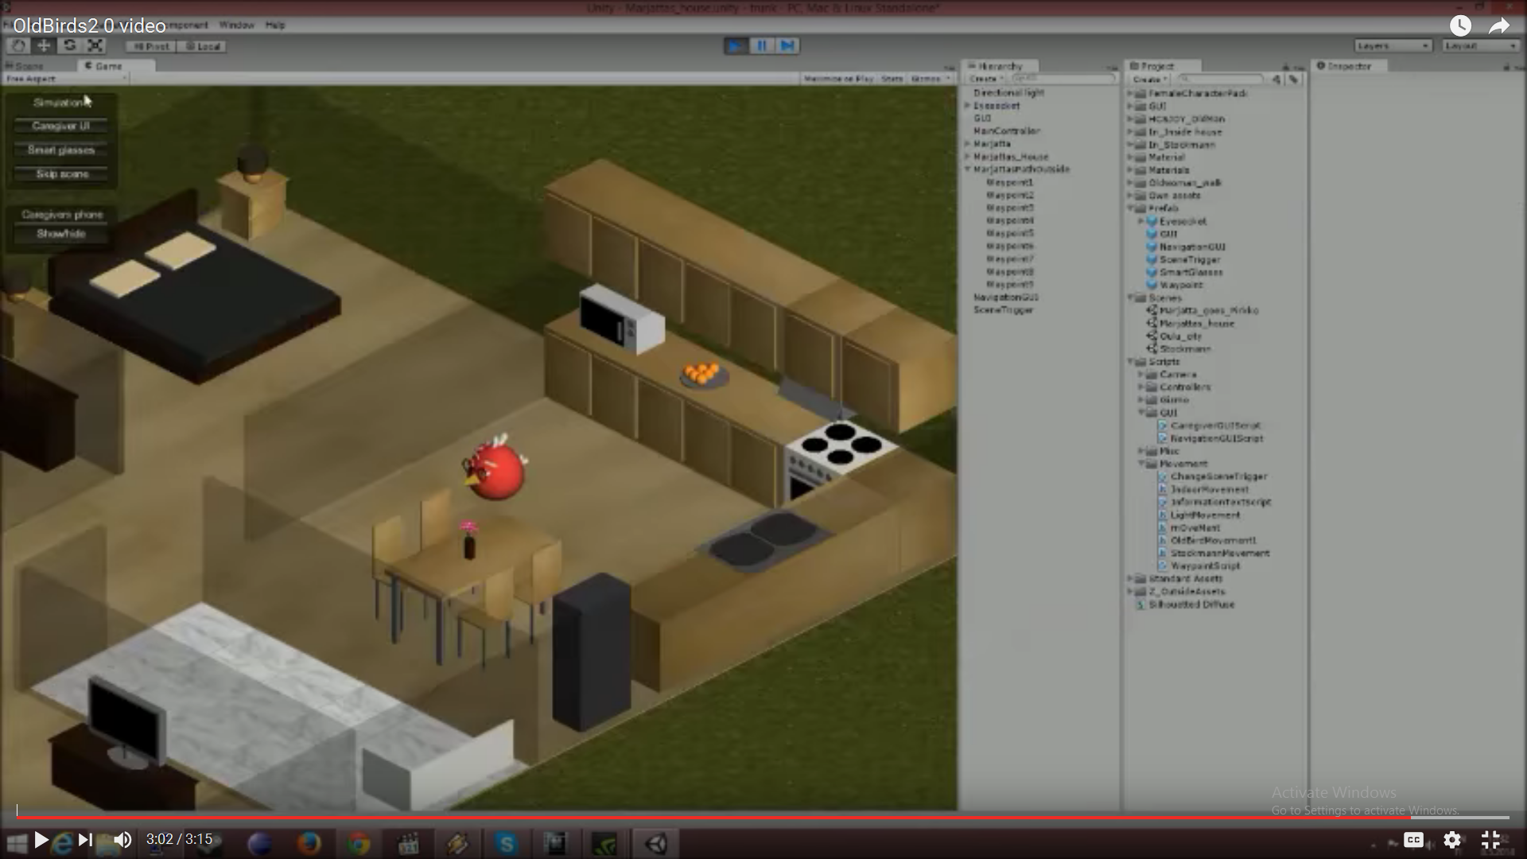
PLATFORM
Unity 3D Environment
Caregiver User Interface
Caregivers Management Panel to administer the avatars and other unity objects

Slide 5
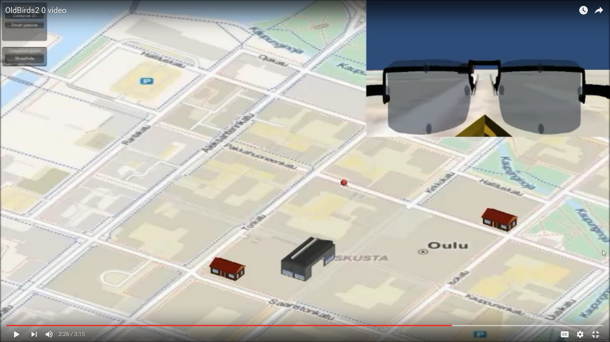
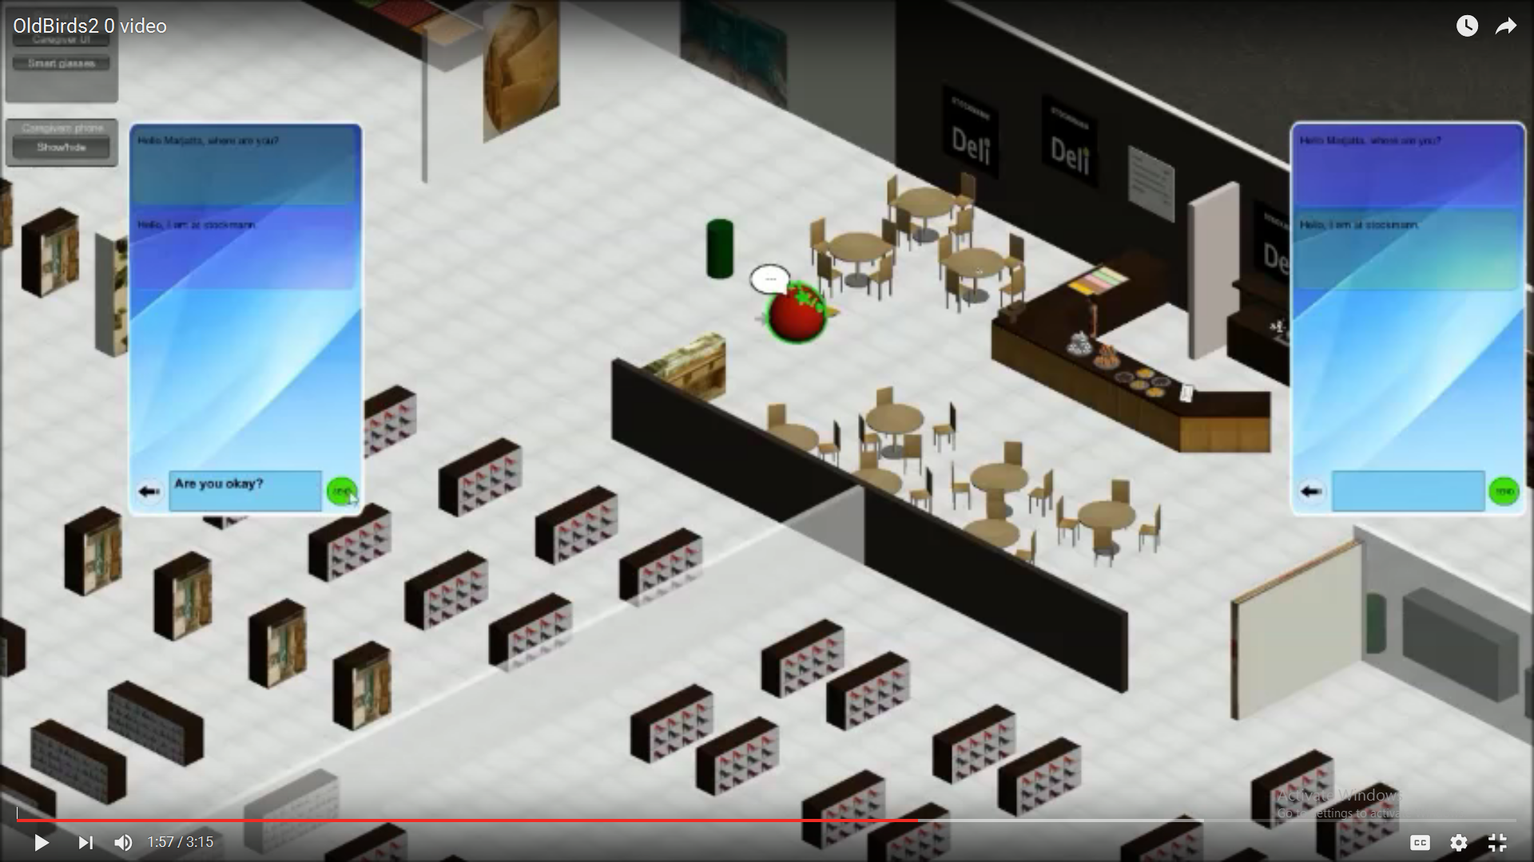
TOOLS
Tools to develop mentoring services:
Unity Game Engine, ZBrush, and Blender for graphics objects
Pupil Pro Device using Python
Android for VOIP service
Linphone API

Slide 6
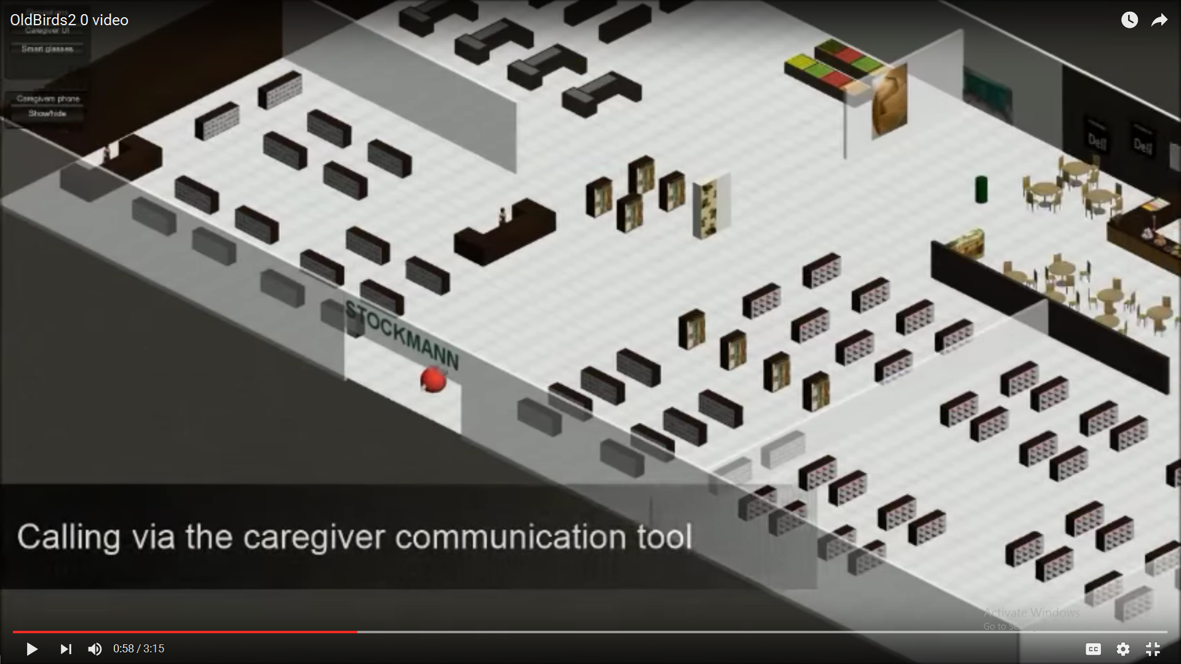
ART STYLE
Serious Game
Learning and Educational Game

Slide 7
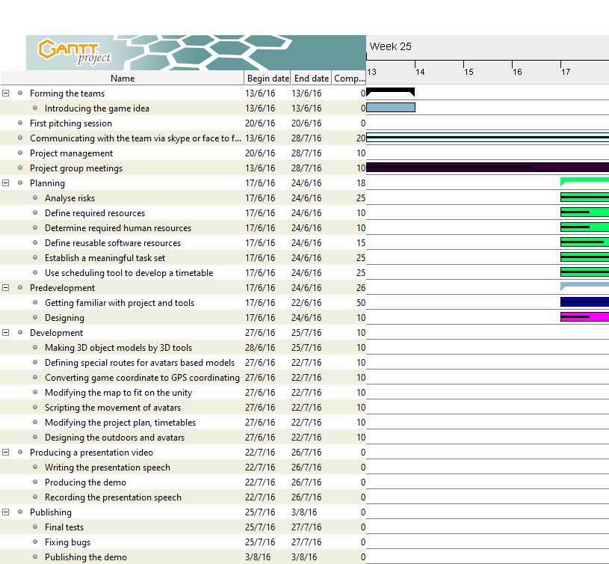
TIME TABLE

Slide 8
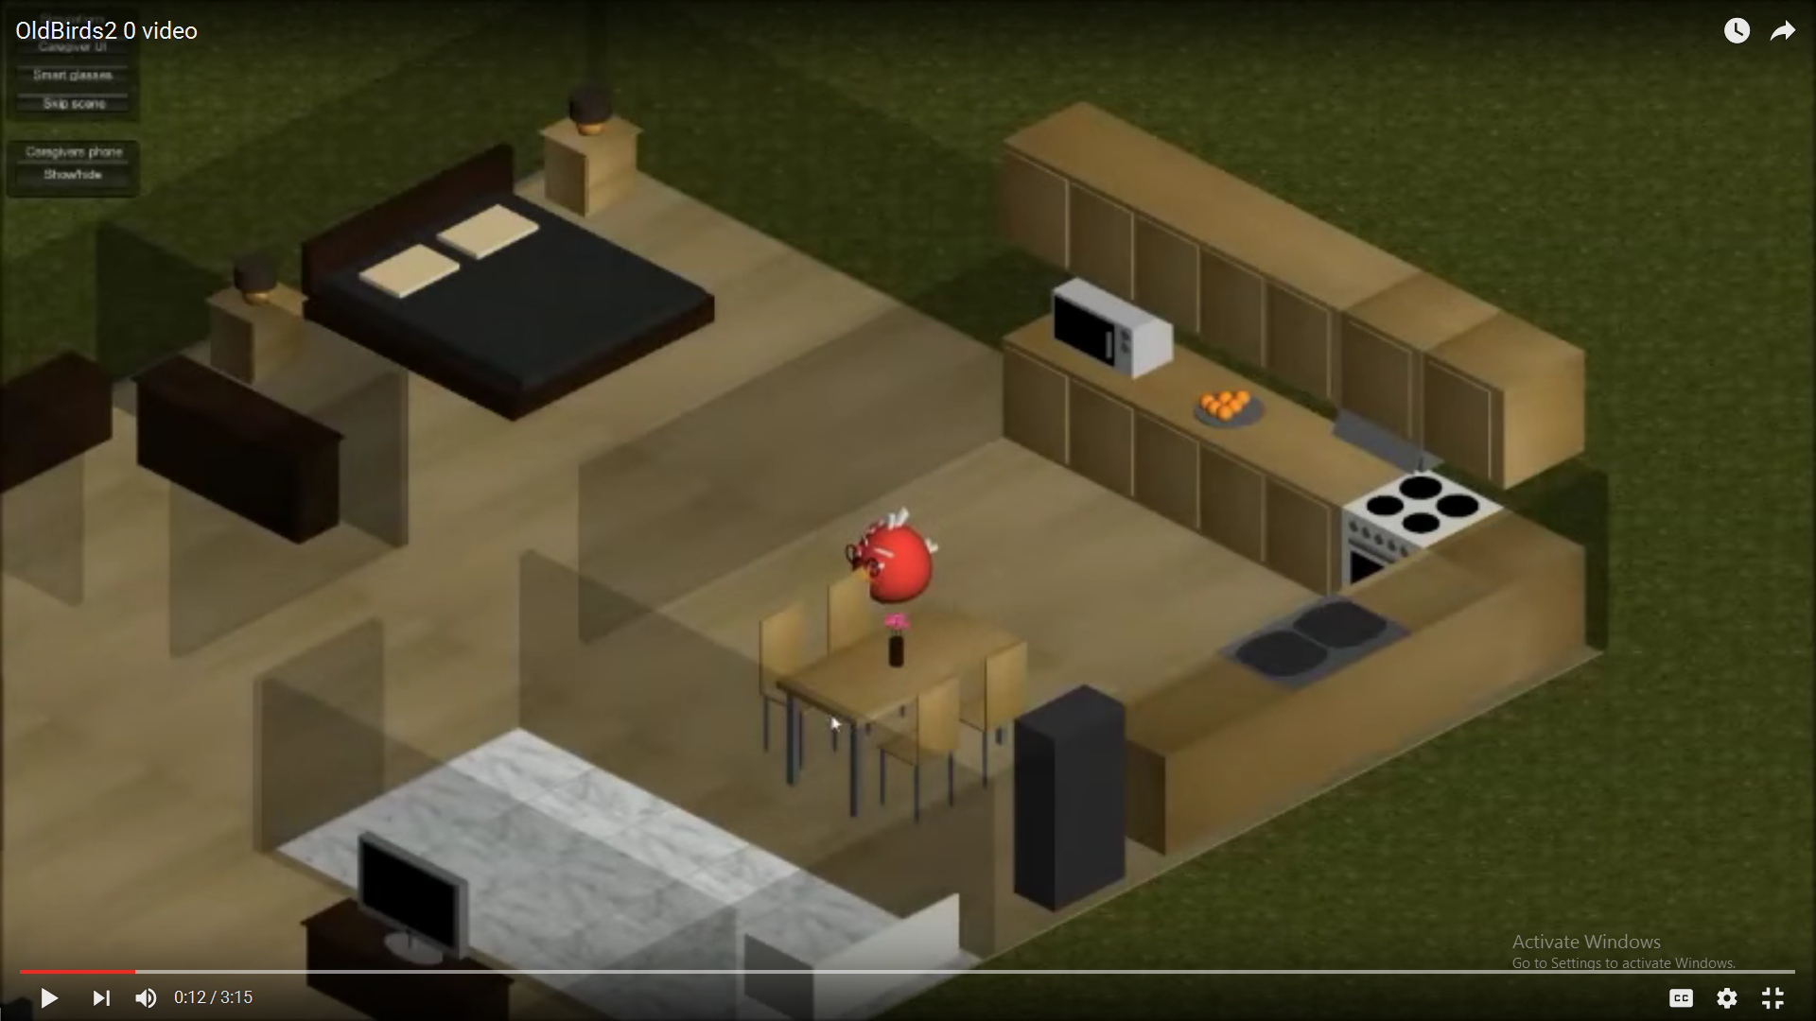
DEMO
https://www.youtube.com/watch?v=2MarZwvjuRs

Slide 9
Thank you
Questions ?

